Slide 1
16CSE09 / Machine Learning Techniques
Unit - 4 / Session – 3
CO4: Model data classification using support vector machines
Topic: Support Vector Classifier

Slide 2
Support Vector Classifier
The maximal margin classifier is a very natural way to perform classification, if a separating hyperplane exists. However, as we have hinted, in many cases no separating hyperplane exists, and so there is no maximal margin classifier.
we can extend the concept of a separating hyperplane in order to develop a hyperplane that almost separates the classes, using a so-called soft margin. The generalization of the maximal margin classifier to the non-separable case is known as the support vector classifier

Slide 3
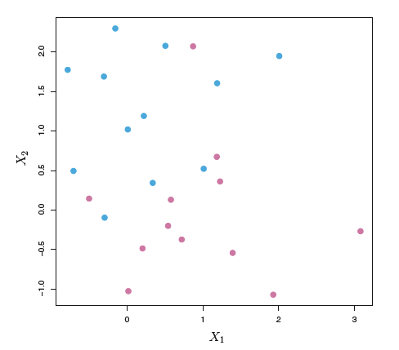
Overview of Support Vector Classifier
There are two classes of observations in the Fig., shown in blue and in purple. In this case, the two classes are not separable by a hyperplane, and so the maximal margin classifier cannot be used.

Slide 4
Support Vector Classifier
we see that observations (previous Fig.) that belong to two classes are not necessarily separable by a hyperplane.
In fact, even if a separating hyperplane does exist, then there are instances in which a classifier based on a separating hyperplane might not be desirable.
A classifier based on a separating hyperplane will necessarily perfectly classify all of the training observations; this can lead to sensitivity to individual observations.

Slide 5
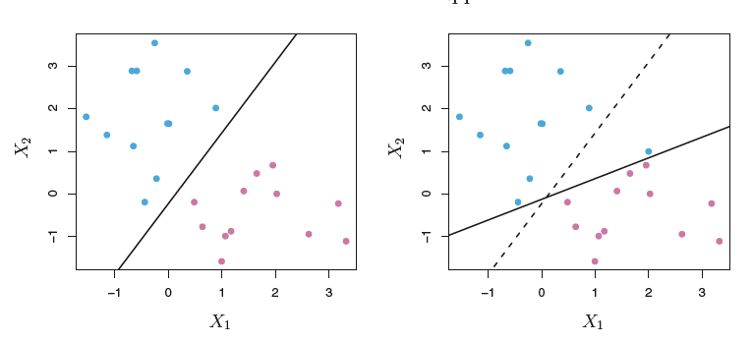
Support Vector Classifier
Left: Two classes of observations are shown in blue and in purple, along with the maximal margin hyperplane. Right: An additional blue observation has been added, leading to a dramatic shift in the maximal margin hyperplane shown as a solid line. The dashed line indicates the maximal margin hyperplane that was obtained in the absence of this additional point.

Slide 6
Support Vector Classifier
The addition of a single observation in the right-hand panel of [previous Fig.] leads to a dramatic change in the maximal margin hyperplane. The resulting maximal margin hyperplane is not satisfactory—for one thing, it has only a tiny margin.
This is problematic because as discussed previously, the distance of an observation from the hyperplane can be seen as a measure of our confidence that the observation was correctly classified.
Moreover, the fact that the maximal margin hyperplane is extremely sensitive to a change in a single observation suggests that it may have overfit the training data.

Slide 7
Support Vector Classifier
In this case, we might be willing to consider a classifier based on a hyperplane that does not perfectly separate the two classes, in the interest of
Greater robustness to individual observations, and
Better classification of most of the training observations.
That is, it could be worthwhile to misclassify a few training observations in order to do a better job in classifying the remaining observations.
The support vector classifier, sometimes called a soft margin classifier does exactly this.
Rather than seeking the largest possible margin so that every observation is not only on the correct side of the hyperplane but also on the correct side of the margin, we instead allow some observations to be on the incorrect side of the margin, or even the incorrect side of the hyperplane.

Slide 8
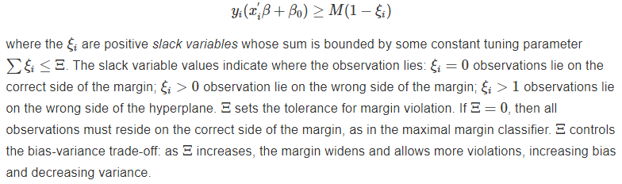
Support Vector Classifier
The maximal margin classifier can be generalized to non-separable cases using a so-called soft margin. The generalization is called the support vector classifier.
The soft margin allows some misclassification in the interest of greater robustness to individual observations.
The support vector classifier optimizes

Slide 9

Support Vector Classifier
The support vector classifier is usually defined by dropping the ||β||=1 constraint, and defining M=1/||β||. The optimization problem then becomes
This is a quadratic equation with linear inequality constraints, so it is a convex optimization problem which can be solved using Lagrange multipliers.

Slide 10

Summary
In this session, we have learned about ,
Support Vector Classifier

